Slide 1
APP SERVICE

Slide 2
What is azure app service
App Service is a Platform as a Service (PaaS) offering from Microsoft. We use it to host web applications, REST API's and backend services for mobile applications.
It doesn't really matter which programming language or framework you have used.
Web applications and services that are developed using any of the following programming languages or frameworks can be hosted using azure app service. It could be
.NET
.NET Core
Java
Ruby
Node.js
PHP
Python

Slide 3
Why use App Service?
Multiple languages and frameworks - App Service has first-class support for ASP.NET, ASP.NET Core, Java, Ruby, Node.js, PHP, or Python. You can also run PowerShell and other scripts or executables as background services.
Security and compliance - App Service is ISO, SOC, and PCI compliant. Authenticate users with Azure Active Directory, Google, Facebook, Twitter, or Microsoft account. Create IP address restrictions and manage service identities. Prevent subdomain takeovers.
API and mobile features - App Service provides turn-key CORS support for RESTful API scenarios, and simplifies mobile app scenarios by enabling authentication, offline data sync, push notifications, and more.
Serverless code - Run a code snippet or script on-demand without having to explicitly provision or manage infrastructure, and pay only for the compute time your code actually uses (see Azure Functions).
DevOps optimization - Set up continuous integration and deployment with Azure DevOps, GitHub, Bit Bucket, Docker Hub, or Azure Container Registry. Promote updates through test and staging environments. Manage your apps in App Service by using Azure PowerShell or the cross-platform command-line interface (CLI).
Global scale with high availability - Scale up or out manually or automatically. Host your apps anywhere in Microsoft's global data center infrastructure, and the App Service SLA promises high availability.

Slide 4
APP SERVICE ENVIRONMENT OVERVIEW
An App Service Environment can host your:
Windows web apps
Linux web apps
Docker containers (Windows and Linux)
Functions
Logic apps (Standard)
App Service Environments are appropriate for application workloads that require:
High scale.
Isolation and secure network access.
High memory utilization.
High requests per second (RPS). You can create multiple App Service Environments in a single Azure region or across multiple Azure regions. This flexibility makes an App Service Environment ideal for horizontally scaling stateless applications with a high RPS requirement.
An App Service Environment can host applications from only one customer, and they do so on one of their virtual networks. Customers have fine-grained control over inbound and outbound application network traffic. Applications can establish high-speed secure connections over VPNs to on-premises corporate resources.

Slide 5
What is App Service Plan
To create App Service, you need an App Service Plan. Without an App Service Plan you cannot create App Service.
So, in the Azure portal, when you try to create app service, you will have to select an app service plan if you have one already or create a new one.
The point is, without an App Service Plan, you cannot create App Service. This is beacuse it is the App Service Plan that defines the compute resources required for your application to run.

Slide 6
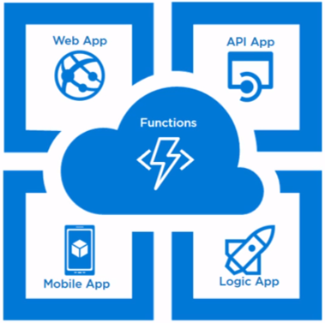
Types of Azure App Services
WEB APPS:
Web Apps enables us to host our web application without worrying about the infrastructure plumbing that is required.
API APPS:
API apps are offering of App Service that helps to host Web APIs. This enables us to expose existing or new APIs . This is also a part of the platform as a service and we don’t need to worry about infrastructure plumbing to bring our APIs up and running.
MOBILE APPS:
Mobile Apps enable us to build a backend for Mobile applications. It can provide capabilities to mobile client applications. This can be considered to be the same as a web service to support mobile client scenarios. The client can be Windows Universal apps, IOS apps, windows apps etc. They are cross-platform. That means Apps build for any platform – Android, Windows, IOS can consume them.
LOGIC APPS:
Logic apps enables us to create functional workflows by orchestrating software as a service component.
These are basically used to connect different components of a solution in order to manage and trigger events and perform the desired action on some other service.

Slide 7
BENEFITS OF USING AZURE APP SERVICE
Fully managed environment
Multiple programming languages and frameworks are supported
Scalability
Compliance
Security
Support for containerization and docker
Devops optimization

Slide 8
App Services Architecture:
Azure App service runs on the top of Microsoft’s PaaS offering.
Applications can be containerized and packaged to be scalable and platform-independent.
App service provides CDN for cross geographic delivery of your application and automatic backup, application firewall, and health and performance monitoring tool.
It accepts SSL for security.

Slide 9
THANK YOU

